Slide 1
Predicting Housing Prices
Institute of data
Charles Apaw
20/07/2024

Slide 2
Business Context
Objective: Predict housing prices based on a variety of attributes related to the accommodation and applying factors affecting its price. Business Problem: Real estate companies are in constant need of price forecasts, so that they can set the right and acceptable prices to their consumers and make the right investment decisions on the available market

Slide 3
Dataset Overview
Dataset: Housing prices dataset with features related to house characteristics and sales.
Key Features:
Numerical: Sale Price, Living Area of the building, size of the basement and so on.
Categorical: Type of Neighborhood, type of House, Physical state, etc.
Goal: Predict sale prices based on features

Slide 4
Data Wrangling and Preparation
Missing Values:
Numerical Features: Imputed with median values.
Categorical Features: Imputed with mode values.
Encoding: Categorical variables converted into numerical format using one-hot encoding.
Feature Engineering: Created new features like TotalSF.

Slide 5
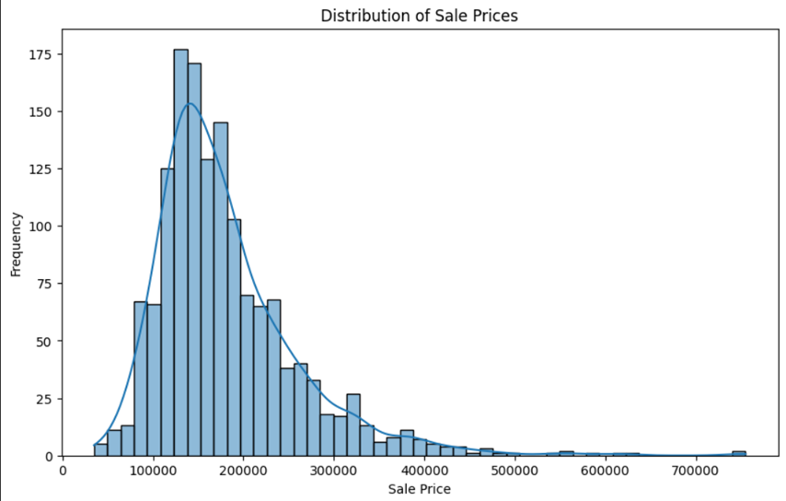
Exploratory Data Analysis (EDA) Distribution of Sale Prices: Histogram Showing Price Spread

Slide 6
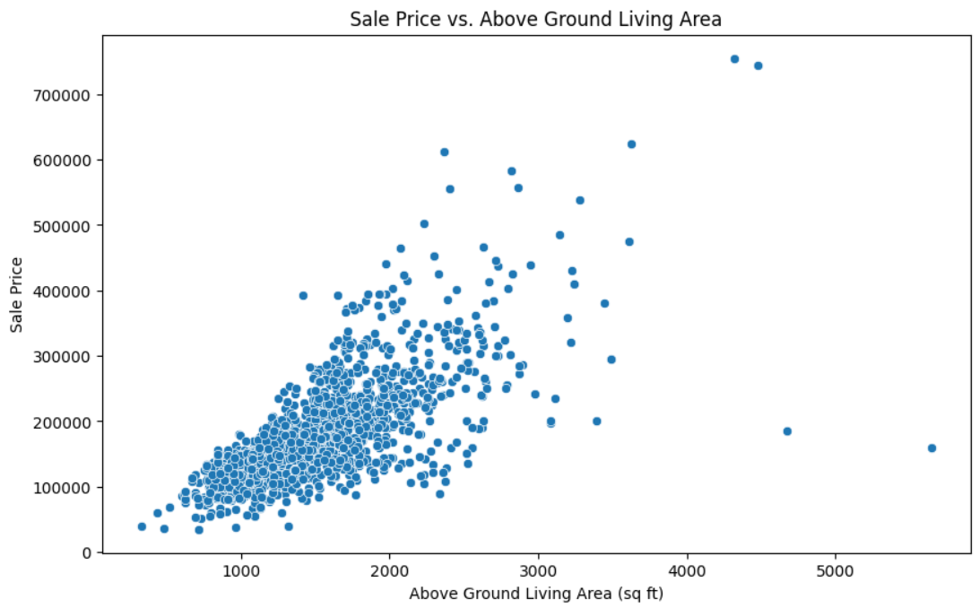
Relationship Analysis: Scatter Plot of Above Ground Living Area vs. Sale Price

Slide 7
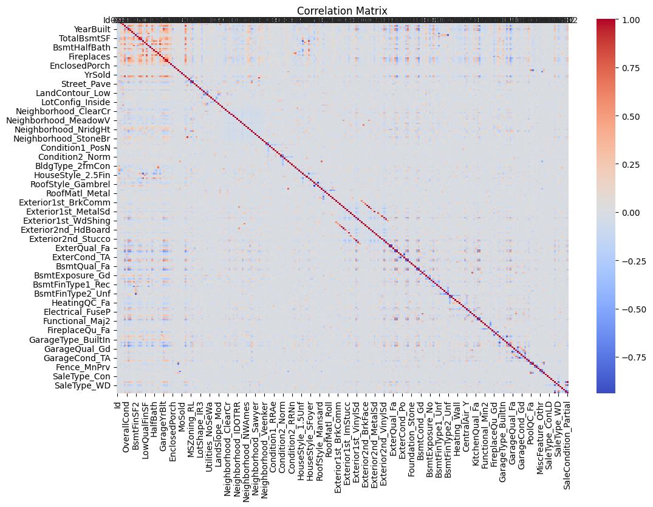
Correlation Matrix: Heat map Showing Feature Correlations

Slide 8
Regression Model
Model: Linear Regression
Training and Testing:
Training Set: 80% of data
Testing Set: 20% of data
Evaluation Metrics:
Mean Squared Error (MSE)
R^2 Score

Slide 9
Key Findings and Business Implications
Findings: Features like living area and neighborhood impact prices significantly.
Implications: Better pricing strategies, improved market analysis, and informed investment decisions

Slide 10
Next Steps and Recommendations
Refinement: Explore advanced models and additional features.
Action Plan: Implement real-time pricing predictions and update the model with new data.

Slide 11
Reference
Kaggle (n.d). House Prices - Advanced Regression Techniques. Retrieved from: https://www.kaggle.com/competitions/house-prices-advanced-regression-techniques/data?select=train.csv

